Slide 1
LabVIEW Unit Test Framework
David maidman
Control software solutions ltd
www.controlsoftwaresolutions.com

Slide 2
Introduction
Introduction to and the benefits of unit testing
Creating and running simple unit tests using the LabVIEW Unit Test Framework (UTF)
Adding test cases and test vectors to a unit test
Setup and Teardown VIs
Generating user defined tests from a test template
Guidelines – when to create a unit test
Test Driven Development (TDD)
References and useful online resources
Questions/Discussion
www.controlsoftwaresolutions.com

Slide 3
What is unit testing?
“The primary goal of unit testing is to take the smallest piece of testable software in the application, isolate it from the remainder of the code, and determine whether it behaves exactly as you expect.
Each unit is tested separately before integrating them into modules to test the interfaces between modules. Unit testing has proven its value in that a large percentage of defects are identified during its use”
http://msdn.microsoft.com/
www.controlsoftwaresolutions.com

Slide 4
Benefits of unit testing
Finds problems early
Reduces the chance of bugs being introduced
Allows regression testing to ensure that the code still work properly when changes have been made
Improves your coding standard (a VI that is written to be testable is more likely to be readable and be loosely coupled)
Aides documentation by providing developers with examples of the intended use of the unit
Allows you to demonstrate requirement coverage for validation in regulated industries
Allows you to quickly locate and fix bugs
Fixing bugs in development is far cheaper than fixing a bug in a released application
www.controlsoftwaresolutions.com

Slide 5
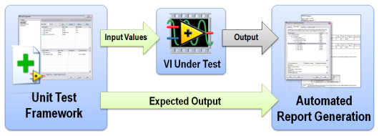
LabVIEW Unit Test Framework
Image from Prove It Works: Using the Unit Test Framework for Software Validation
www.controlsoftwaresolutions.com

Slide 6
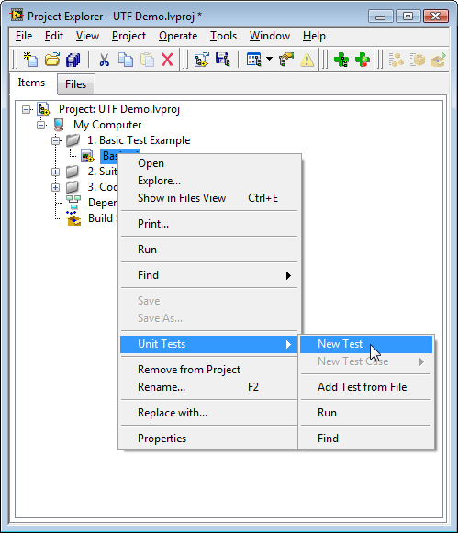
Creating a unit test using the UTF
Unit tests are created in and run from the LabVIEW project environment
Unit tests are simple text files with a *.lvtest extension
To create a unit test follow these steps: -
Right click on the VI under test in the Project Explorer
Select the Unit Tests>>New Test menu item
Right click on the test and select the Properties menu item
Next step?
Define test cases and test vectors – how????
Image from Prove It Works: Using the Unit Test Framework for Software Validation
www.controlsoftwaresolutions.com

Slide 7
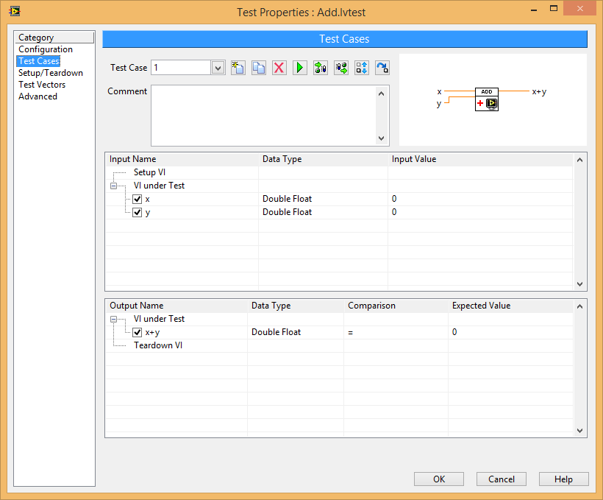
Adding test cases
The Test Cases tab of the unit test properties allows you to configure the test cases.
For each test that you create: -
Enter a comment describing the test case
Define the inputs and expected outputs to create your test
Click run to run your test case
Advanced:
Use the import to and export from VI controls to interact directly with the VI.
Other controls on the front panel can be tested by changing the Configuration on the Advanced tab
www.controlsoftwaresolutions.com

Slide 8
Running unit tests
Individual test cases: Click Run in the Test Cases tab of the Test Properties
Individual test (all test cases): Right click on the test and select the Run menu item
All tests in a folder/library: Right click the folder/library and select the Unit Tests>>Run menu item
All tests in a project: Click Run Unit Tests toolbar button
www.controlsoftwaresolutions.com

Slide 9
Example: Basic Functions.lvproj
www.controlsoftwaresolutions.com

Slide 10
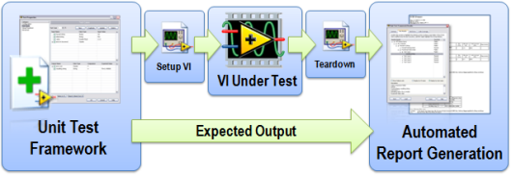
Setup and teardown
Setup and tear down functions are required for: -
VIs that have state configuration and setup, for example FGVs and Action Engines
VIs that require programmatic configuration of the inputs of the unit under test, for example creating references or large data sets.
VIs that require post test clean-up, for example closing references
Image from Prove It Works: Using the Unit Test Framework for Software Validation
www.controlsoftwaresolutions.com

Slide 11
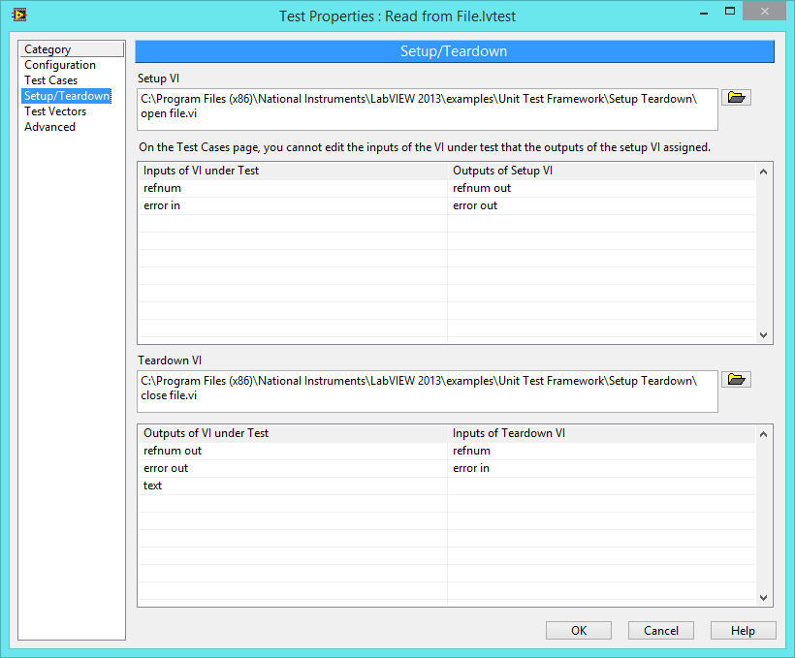
Setup and teardown
To view the setup and tear down properties select the Setup/Teardown tab in the unit test properties
www.controlsoftwaresolutions.com

Slide 12
Example: Setup Teardown.lvproj
www.controlsoftwaresolutions.com

Slide 13
Adding test vectors
Test vectors allow large number of test cases to be run using data configured in one or more test vector file.
This allows large data ranges to be tested, for example testing lookup tables
Allows libraries routine tests to be created
www.controlsoftwaresolutions.com

Slide 14
Example: Vector Generation.lvproj
www.controlsoftwaresolutions.com

Slide 15
User defined tests
User defined tests allow you to write tests using a VI template rather than through the Test Cases tab.
The user defined test can include multiple test cases and setup and tear down functions
Can be used to create more complex units and integration tests
Is a good method of documenting how a function should be used
To create a user defined test right click the VI under test and select the Unit Tests>>New User Defined Test menu item
www.controlsoftwaresolutions.com

Slide 16
Example: User-Defined Test.lvproj
www.controlsoftwaresolutions.com

Slide 17
CSS Guidelines
These are general guidelines resulting from our use of the unit test framework: -
Do not attempt to create a unit test for every single VI in the project
Create a unit test before refactoring code. Once the code has been refactored you should be able to demonstrate that it still works.
Create a unit test for all bugs. Initially the test should fail, demonstrating the presence of the bug. Once you have fixed the bug the test should pass
Create unit tests for critical sections of code (for example main API functions, critical algorithms etc.
When you have finished working on a library/module run all tests for the library to ensure you have not broken previously working code.
Run all unit tests before performing a source code control merge and committing to the trunk.
Adapt you test strategies as you gain experience
www.controlsoftwaresolutions.com

Slide 18
Test Driven Development (TDD)
TDD involves writing the tests before writing the code, and then writing just enough code to pass the tests.
Quickly add a test
Run the tests and see the new test fail
Make a little change
Run the tests and see the new test pass
Refactor and remove duplication
www.controlsoftwaresolutions.com

Slide 19
Summary
The LabVIEW Unit Test Framework provides a simple and elegant method for performing automated test for validation and regression testing of VIs.
www.controlsoftwaresolutions.com

Slide 20
References
Online resources:
LabVIEW 2013 Unit Test Framework Toolkit Help
Prove It Works: Using the Unit Test Framework for Software Testing and Validation
http://www.jamesmcnally.co.uk/testable-code-labview/
http://msdn.microsoft.com/en-us/library/aa292197%28v=vs.71%29.aspx
Books:
Test Driven Development By Example (Kent Beck, Addison Wesley)
www.controlsoftwaresolutions.com

Slide 21
Questions?
www.controlsoftwaresolutions.com

