Slide 1
Building Distributed systems with LabVIEW and ØMQ.
How to build a distributed system without a large team.
Maciej Kolosko, Partner Composed Systems, CLA , CLED
Notes:
I’m an NI Alliance Partner and that I am a CLA & CLED and have been working with LabVIEW for approx 15 years.
Worked with Composed Systems slightly over a year.
Worked in the
Nuclear
Medical
Oil and Gas
Various Countries.

Slide 2
Presentation overview
Microservices – how distributed cloud systems are built
What is ØMQ and where is it available to use
Demo of connecting Current Gen and NXG with ØMQ
How ØMQ can be used in the kind of systems we build with LabVIEW
Stable vs Unstable networks
Wrap up followed by Q&A
Notes:
These concepts are not new but
ZMQ is 10 years old.
Distributed systems are an old concept.
They are a good of segregating
This can be used for migration.

Slide 3
Aspects of distributed systems
Componentization via Services
Segregation oriented to Business Capabilities rather than Technlology
Decentralized governance
Decentralized data management
Design for failure
Smart endpoints and dumb pipes
Notes:
The points are taken from M. Fowlers talk about Microservices.
They describe how the industry is going about building service based architectures these days.

Slide 4
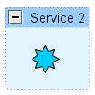
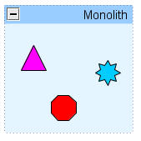
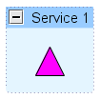
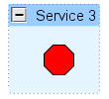
Componentization via Services
Notes:
Components are ways we organize software.
In OO programming they could represent top level classes of a program.
In micro services they represent aspects of the system that can be organized into different software components from the stand point of business capability.

Slide 5
Organizing vs capabilities
User Interface
Business Logic
Database
Notes:
This is the old school way of organizing resources.
This is how a monolith application teams would be organized, this reflects both the way the human skill set would be pulled in line to match the technology used.

Slide 6
Organizing vs Business Capabilities
Orders
Catalog
Shipping
Notes:
This kind of organization of resources and skills allows for
Decentralized governance
Different release cycles
Different versions of different libraries
Decentralized data management
Ortientation toward the business capabilities of a distributed system.
Simian Army

Slide 7
Building for failure
Randomly shuts down your services and VM’s in your deployment structure
https://github.com/Netflix/chaosmonkey
Notes:
Netflix has developed the Chaos Monkey.
A process/service killing program which forces the services to build resilience.
It keeps the service designers on their toes, and makes sure that their servic
Chaos engineering can be used to achieve resilience against:
Infrastructure failures
Network failures
Application failures
e can handle the dissaperance of other services it depends on graciously.

Slide 8
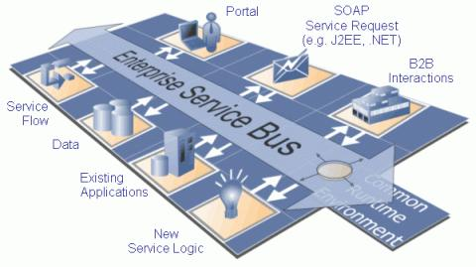
The ESB : The smart pipe.
Notes:
The Enterprise Service Bus used to be popular concept in the Service Oriented Architecture and design when it was first becoming popular.
It was quite complex and required large amounts of knowledge, and enterprise size teams.

Slide 9
SMART ENDPOINTS DUMB PIPES: What is zero ØMQ?
It’s not another message queue.
ØMQ – not a daemon not a server. It is a library.
It does not bring any additional dependencies with it.
It is a very lightweight socket system.
It was built for financial markets, to handle a high volume of messages.
Notes:
ZMQ is not another message queue.
It’s lightweight.
Even the GUID implementation has been changed inside of ZMQ in order for it not to depend on external code
So that it does not require ANY external dependencies.

Slide 10
ØMQ AVAILIBLITY
Language bindings which use the C++ implementation are available for C#, JAVA, C , LabVIEW , Python , F#, Lua, PHP and many … many more http://zeromq.org/bindings:_start
Java and C# stack supported as direct implementations.
Supported operating systems include :
Windows
Unix / Linux
iOS, Android
WxWorks
Notes:
Currently on the ZMQ website there are 50 bindings.
Important to note that the Java and C# implementations are pure and supported if needed.

Slide 11
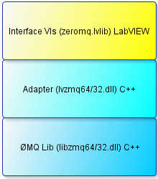
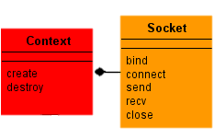
ØMQ binding for current gen
Three layers of libraries
Prominent Classes
Context
Thread safe
Manages I/O threads
Socket
Manages a single endpoints
Not thread safe
Notes:
Martijn Jasperse – is the author of the current Gen ZMQ binding needs mentioning.

Slide 12
Examples : connecting current gen and NXG using ØMQ
Example of connecting LabVIEW current GEN and NXG though ØMQ and the use of REQ / REP pattern
Overview of the example code, and brief discussion about the process of porting a portion of the Zero MQ binding from current gen to next gen.
Notes:
Example of connecting current gen LabVIEW with NXG LabVIEW.
Request / Reply pattern demonstration of the two Dev Environments passing messages
UTF – 8 encoding in NXG vs the old ASCII encoding
What is cool, SLI node, Gtype instead of control stuff makes sense.
Demonstrate that we can send Anything over ZMQ by sending a bunch of images over ØMQ from Current Gen to NXG.
Total time ~ 4 minutes for demo
About 7 minutes to go over the experience of exporting the ZMQ binding to NXG from old LabVIEW
Talk about SLI node.

Slide 13
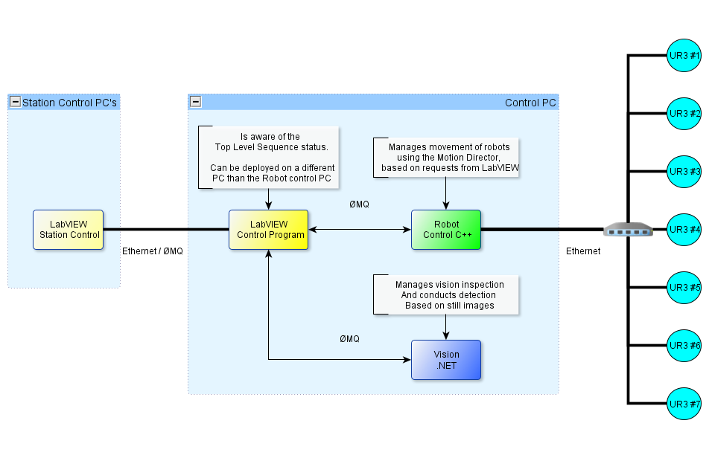
Real world system example
Nodes distributed on a LAN
Some are powered by LabVIEW current gen
Some are C++
Some are .NET / C#
Notes:
LabVIEW nodes are able to talk to each other by exchanging LabVIEW Objects and deserialize them though malleable API capable of detecting acceptable types.
The communication between the other nodes will be done via Cluster -> JSON and than consumed by the endpoint appropriate data types.

Slide 14
Messages ØMQ
Notes:
LabVIEW to LabVIEW – we can flatten and unflatten a LabVIEW Class.
LabVIEW to C# or C++ - we can use a cluster (Gtype) and JSON to transmit messages from one station to another.

Slide 15
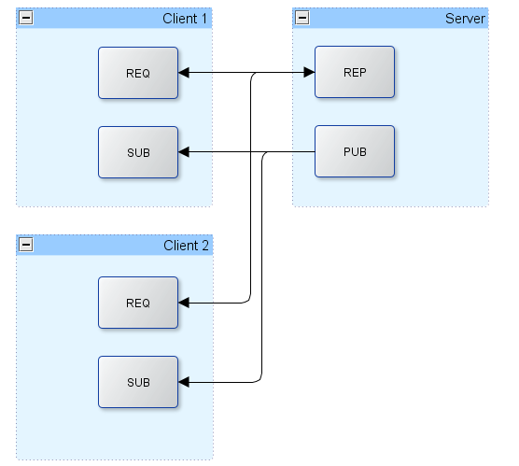
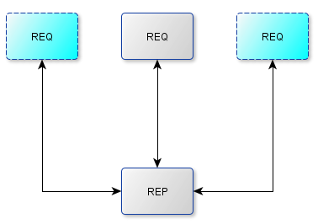
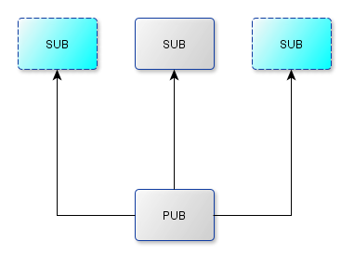
Zero MQ Communication scheme
http://zeromq.org
http://www.gnu.org/licenses/lgpl.html
Notes:
Here is how you can mix 2 sockets together to enable communication between multiple systems.
Requesting and publishing is what you need to build a system with one central node and as many clients that you need.
PUB and SUB
REQ and REP
REQ and ROUTER (take care, REQ inserts an extra null frame)
DEALER and REP (take care, REP assumes a null frame)
DEALER and ROUTER
DEALER and DEALER
ROUTER and ROUTER
PUSH and PULL
PAIR and PAIR

Slide 16
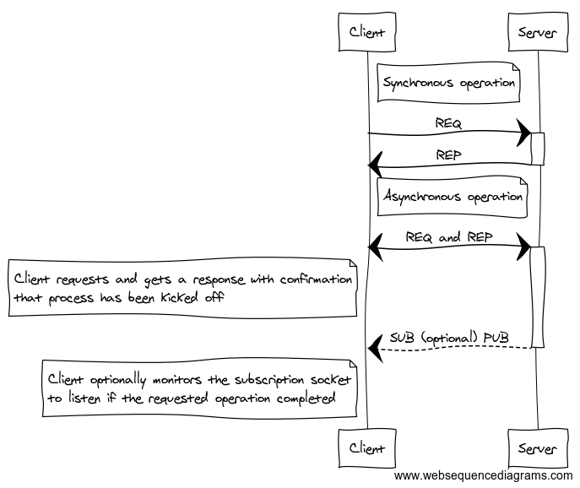
Synchronous vs Asynchronous operation
PUB : socket enveloping
Notes:
Mixing 2 sockets together to come up with your own communication pattern to suit your applicaiton needs.
I’ll discuss how this pattern is used to control robot motions in my applicaiton.

Slide 17
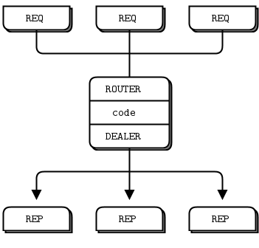
STABLE vs UNSTABLE Design
What is stable design and what is unstable design.
Bind vs Connect
How does that influence our design.
Another demo :
Demonstrate the use of Proxy to create a stable endpoint and connect to unstable endpoints.
Notes:
Stable endpoints are the ones you bind to.
Unstable endpoints are the ones that connect.
It is actually beneficial to design your networks in a way that is mostly unstable, which allows nodes to come and go as they please and scale your system.
This will be followed by a code example reusing the previous demo components to create an unstable network.

Slide 18
Node Presence / Discovery
Video demo of an unstable network. Go to http://labviewcraft.com to watch.
Notes:
Demo of a few executable applications written in LabVIEW discovering each other's presence using UDP multicast and REQ / REP
Total time ~ 6 minutes.
I intend to run this demo live, but in case there are issues etc. I have a prepared video as a backup.

Slide 19
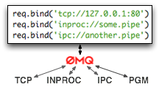
ØMQ Types of transport
Notes:
TCP – is sockets on steroids.
Ipc – in inter process communication only implemented on UNIX systems
Inproc – inter process ( no I/O is performed, can be used to build multi threaded applications ). Recieving end ( Bind needs to exist before Connect )
PGM – Pragmatic General Multicast, allows to send packets without duplicating their contents. It also allows for re-creation of packets from memory in case the client realizes they did not get them as the packets are numbered

Slide 20
Zero MQ Termination
It’s not straightforward at the beginning.
http://zeromq.org/whitepapers:0mq-termination
Notes:
Mention that it is important to understand how the ZMQ termination works, and that the time spent understanding it will save a lot of hustle.
Also mention that there are more communication patterns that come out of the box but have not been mentioned as part of zmq.
Like PUSH / PULL , PAIR etc.
Skip this slide if time is short and leave time for questions.

Slide 21
Questions
Thank you!
Email maciej.kolosko@composedsystems.com
Web https://composed.io
See Examples / Demo Videos http://labviewcraft.com upload coming soon!
Notes:
Leave enough time at the end for questions.
This can be used to connect LabVIEW to other pieces of software quite easily.
This could be used as a migration strategy for your application where you refactor into services, and then re implement the services in whatever makese sense.

