Slide 1
WebSockets: Bringing LabVIEW to the Web
Sam Sharp
sam@mediamongrels.com
2nd October 2017

Slide 2
Introduction
Sam Sharp
LabVIEW Architect
CTD Re-certification pending
Just passed Part 1 of the CLED Exam ☺
LabVIEW Consultant and Director of MediaMongrels Ltd
www.mediamongrels.com
NI Alliance Partner
Distributed Embedded Systems (cRIO, RT, FPGA) and Automated Test (TestStand)
LabVIEW user for ~10 years
Sam_Sharp on the NI Forums
Live on a Narrowboat

Slide 3
Why?
Industry trend towards smartphone/tablet for 24/7 access to information/data
Replacing purpose-built devices for HMI, even in commercial/industrial applications
Embedded devices are becoming more capable (8-core smartphones) and more connected (embedded WiFi, Bluetooth, RFID)
Humans are becoming more familiar with portable touchscreen phones/tablets and using apps or a web-browser – UIs are less skeuomorphic (resembling their real-life counterparts)
Web-browser is cross-device and cross-platform compatible
Seems like a good way to go for some applications…
…but LabVIEW is lacking in some areas:
UIs look ‘typically LabVIEW’ (this is not a good thing!), have not caught up with UI design trends and, at least in current gen LabVIEW, lacks basic capabilities of modern UI design
Limited Web UI functionality (Web Services / Remote Front Panels)
Some half-hearted attempts (data dashboard, LabVIEW touch-panel)
“Mobile access is driven by the need for continuous ubiquitous viewing, from management watching production to an operator remotely adjusting a process”
Control Engineering – An iPhone as your next HMI?

Slide 4
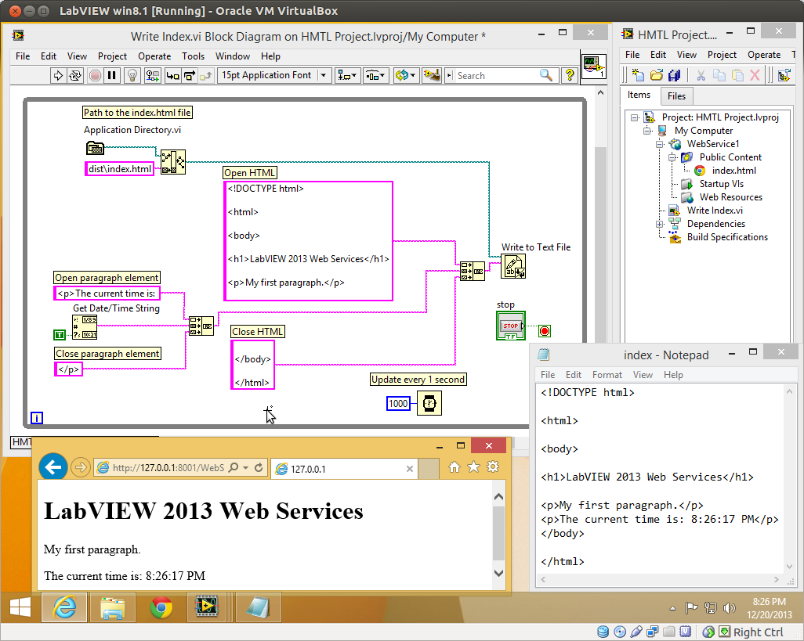
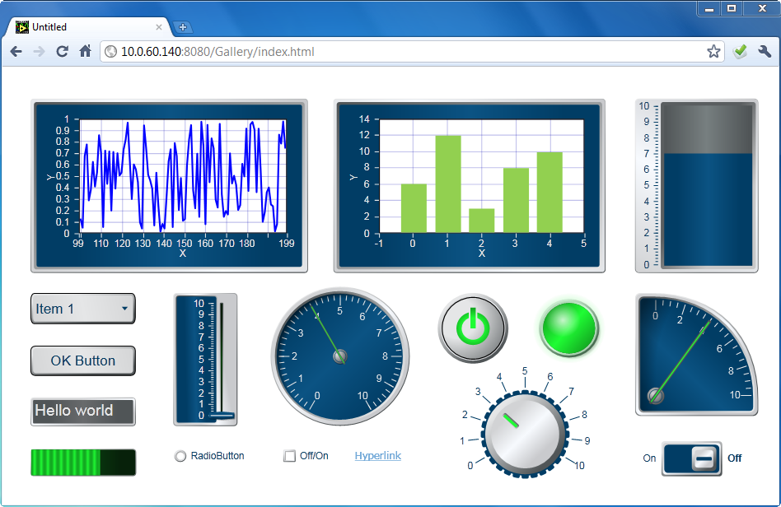
How do we do it with LabVIEW?
Remote Front Panels
LabVIEW Web Services
Web Service VIs
Hosting Static Pages (>= LV2013)
ESP Scripting
Database / Web Server
HTTP Client VIs
DB Connectivity
TCP/IP
Web UI Builder
NI Toolkit
Bergmans Mechatronics – LabSocket
3rd Party Toolkit
http://www.labsocket.com
LVS Tools – WebSocket API
3rd Party Toolkit
http://www.lvs-tools.co.uk
LabVIEW Web Services
Based on WebSockets!
LabVIEW Web UI Builder

Slide 5
Method Comparison
 | Free/Paid | LabVIEW UI | Extra Programming | Mobile Support | Plugins | Latency | Asynchronous
Remote Front Panels | Free | Yes | None | No | LV RTE & Browser Plugin | Low | Yes
Web Services | Free | No | LabVIEW (++) Web (++) | Yes | None | High | No
Web/Database Server | Server? | No | LabVIEW (+) Web (+++) | Yes | None | High | Yes/No
Web UI Builder | Paid | Yes | LabVIEW (+) | No | Silverlight | Low | Yes
WebSockets | Free | No | LabVIEW (++) Web (++) | Yes | None | Low | Yes
Disclaimer: I haven’t tried/used all of these methods in anger so this is only my opinion.

Slide 6
WebSockets – the key!
WebSockets is a HTML5 web technology that allows for TCP-socket-like connections from a browser
Low latency
Asynchronous send/receive of data
Simple protocol – HTTP handshake + message framing over TCP
Widely supported
PC Browsers (IE >=10, Chrome, Safari, Firefox etc.)
Mobile Devices
Defined in RFC6455 (if you need some light reading!)

Slide 7
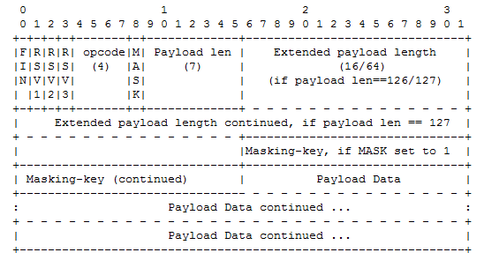
How does it work?
Server listens on specific TCP port
Client connects and sends a HTTP request with an ‘Upgrade: websocket’ header and a hashed key
Server responds with response key
Send/receive WebSocket frames over TCP/IP
HTTP Handshake
Client request:
GET /chat HTTP/1.1
Host: server.example.com
Upgrade: websocket
Connection: Upgrade
Sec-WebSocket-Key: x3JJHMbDL1EzLkh9GBhXDw==
Sec-WebSocket-Protocol: chat, superchat
Sec-WebSocket-Version: 13
Origin: http://example.com
Server response:
HTTP/1.1 101 Switching Protocols
Upgrade: websocket
Connection: Upgrade
Sec-WebSocket-Accept: HSmrc0sMlYUkAGmm5OPpG2HaGWk=
Sec-WebSocket-Protocol: chat
RFC 6455 WebSocket Protocol - Framing

Slide 8
Server: LabVIEW WebSockets Library
Wraps the primitive TCP/IP functions
Works on PC & RT
Used in the same way (listen, open connection, read/write, close)
Simple API – just 5 VIs!
Free!
Available to download through the LabVIEW Tools Network on VIPM
http://www.mediamongrels.com/websockets-library
(or search for “LabVIEW WebSocket library”)
Library also includes WebSockets Client Support
Not tested with 3rd party WebSockets servers

Slide 9
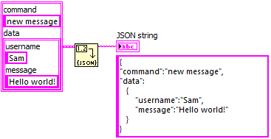
Client: The Catch? Text-based code!
Some JavaScript (& HTML/CSS) knowledge required
Implementing WebSockets in Javascript is really easy!
JSON support in LV2013+ makes API development much easier!

Slide 10
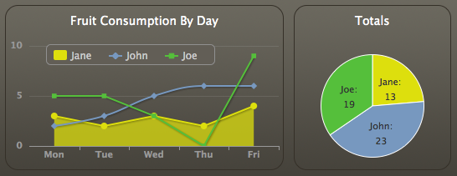
A world of possibilities!
Huge Web Community = Lots of Resources
“50 JavaScript Libraries for Charts and Graphs”
“12 Great JavaScript UI Libraries”
“21 Best JavaScript Frameworks for Developers”
Twitter Bootstrap: “Most popular HTML/CSS/JS framework for developing responsive, mobile first projects on the web.”

Slide 11
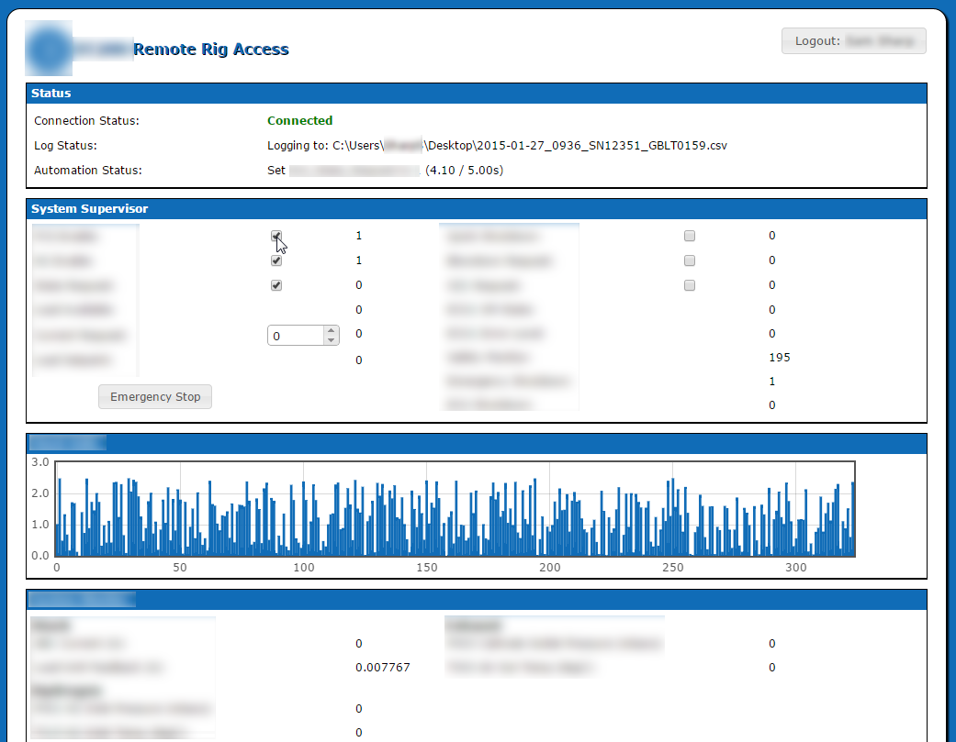
Applications
Remote access and monitoring of test stations
Remote access of CompactRIO control & monitoring applications
Replacing a remote front panel interface
The Future? Tablets instead of test station PCs

Slide 12
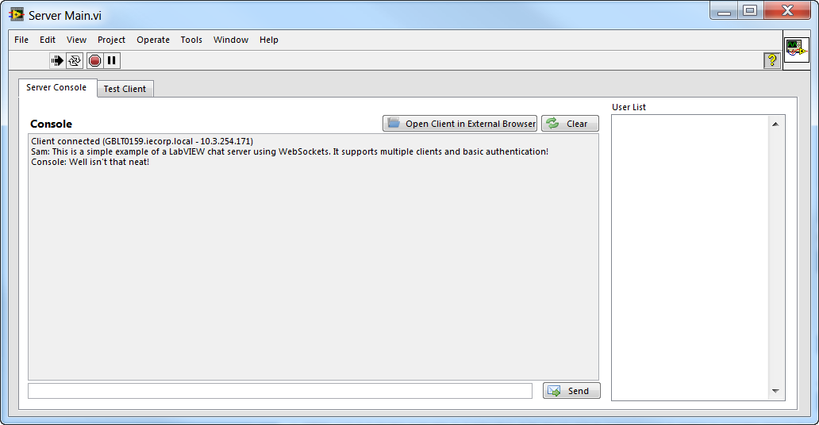
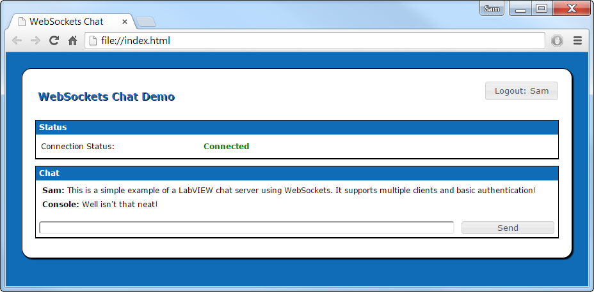
Demo: WebSockets Chat

Slide 13
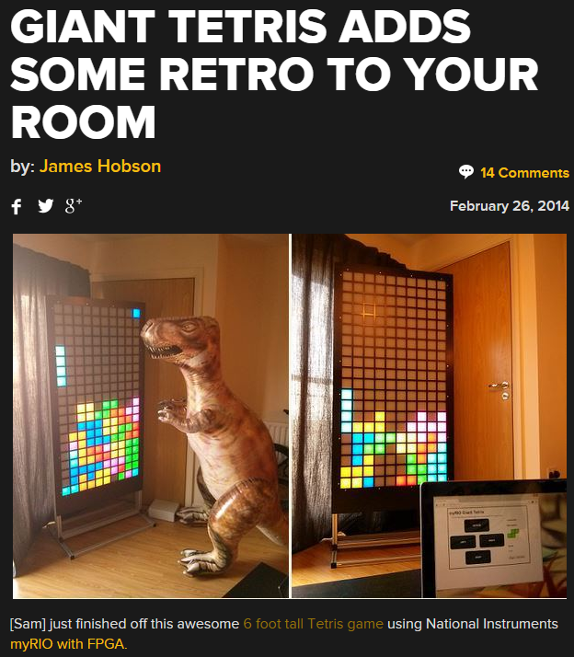
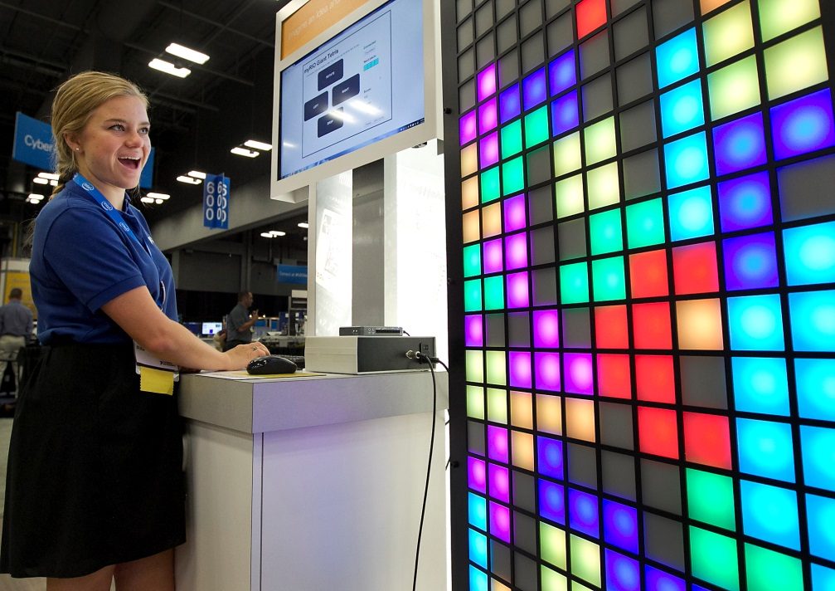
myRIO Giant Tetris
6ft version of Tetris powered by a National Instruments myRIO – on display during NI Week and NI Days 2014
Game uses WebSockets + Browser (PC/Phone) as the controller
NI Week 2014
HACKADAY

Slide 14
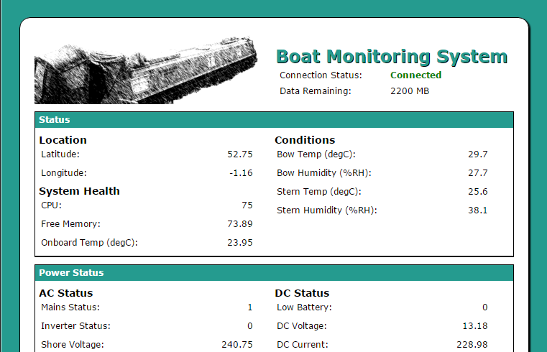
Boat Monitoring System
Narrowboat Monitoring System
sbRIO
Power/Solar Monitoring and Logging
Datalogging to Cloud
Accessing web services (e.g. weather / GPS mapping)
WebSockets dashboard
As library is based on TCP/IP primitives, it also runs on LabVIEW RT.
Ported to Raspberry Pi in 2017 (just to see what would happen!)
You can deploy LabVIEW RT code to RPi’s…but for non-commercial use only!
Uses LINX toolkit

Slide 15
Demo: Boat Monitoring System

Slide 16
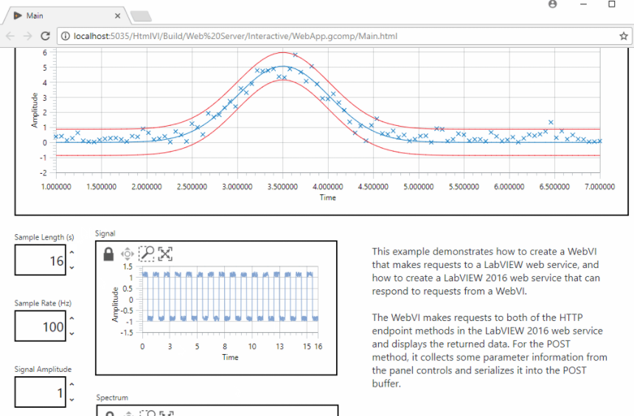
The Future?
LabVIEW NXG 2.0 is set to introduce WebVIs...
LabVIEW code running on a client’s web browser
Demo at http://www.webvi.io/
Very interested to see what can be done with these! ☺
Hopefully the API/tools are available to implement similar applications, but purely in LabVIEW

Slide 17
The End
Any questions?
WebSockets URL: http://www.mediamongrels.com/websockets-library
(includes links to sample code and other presentations)

